Slide 1
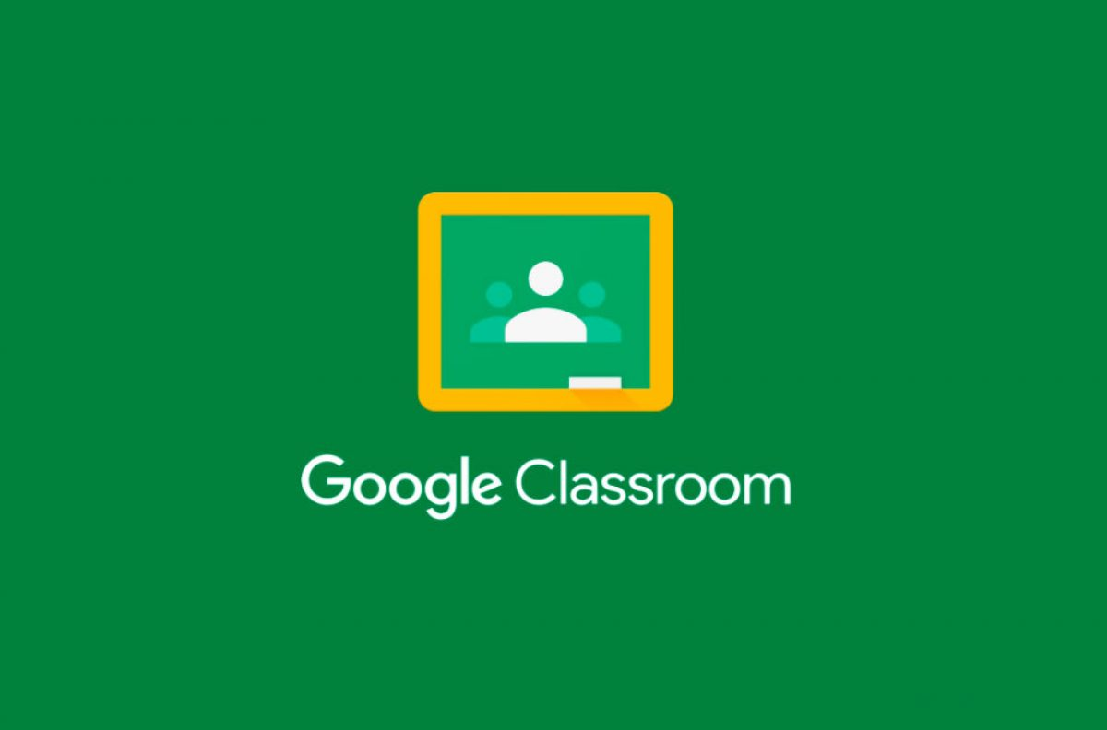
Google Classroom
Developer - Mrs. Rochelle
Initial release - August 12 (2014)
It is a free blended learning platform
It is available on the web or by mobile app
It does not scan any of the data for your phone
It is always updating with new integrations that allow you to access lots of free-to-use tools aimed to help make teaching and learning

Slide 2
Google Classroom was developed by Google for educational institutions that aims to simplify creating, distributing, and grading assignments.
The primary purpose of Google Classroom is to streamline the process of sharing files between teachers and students.
Google Classroom is your all-in-one place for teaching and learning.
Our easy-to-use and secure tool helps educators manage, measure, and enrich learning experiences.

Slide 3
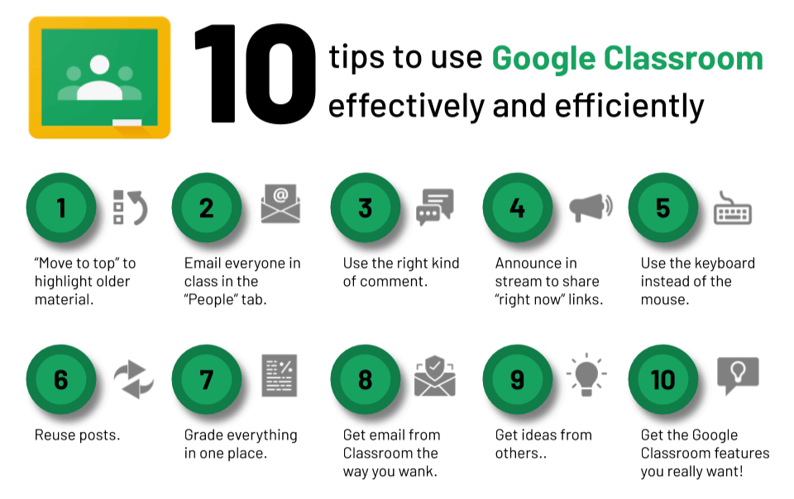
What can you do with Google classroom ?
Teacher - Create and manage classes, assignment and grade online without paper
Students - Track classworks and submission of assignment
Administrators - Product data and set permission for your users

Slide 4
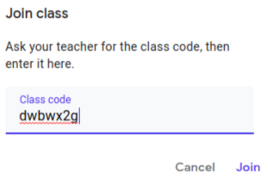
How to use Google Classroom ?
As a student: To join a class, sign in on a computer or mobile device. After you join a class on one device, you’re enrolled in that class for all devices.
There are two ways to join a class:
For Code:
Copy that code your teacher Shared
Click on '+'
click on 'Join class'
Paste your code in 'class code box'
click 'join'
For Link:
Click on the class link your teacher shared select the account you want to use for Classroom
click 'Join'

Slide 5
Thankyou
This is an amazing part of this digital too!

